Slide 1

Minnesota Traffic Volume Project Analyzing Traffic Trends to support Infrastructure Decisions
May 2025
Antoine Nassaux
Notes:
Pour remplacer l’image sur cette diapositive, sélectionnez-la et supprimez-la. Cliquez ensuite sur l’icône Images dans l’espace réservé pour insérer votre image.

Slide 2
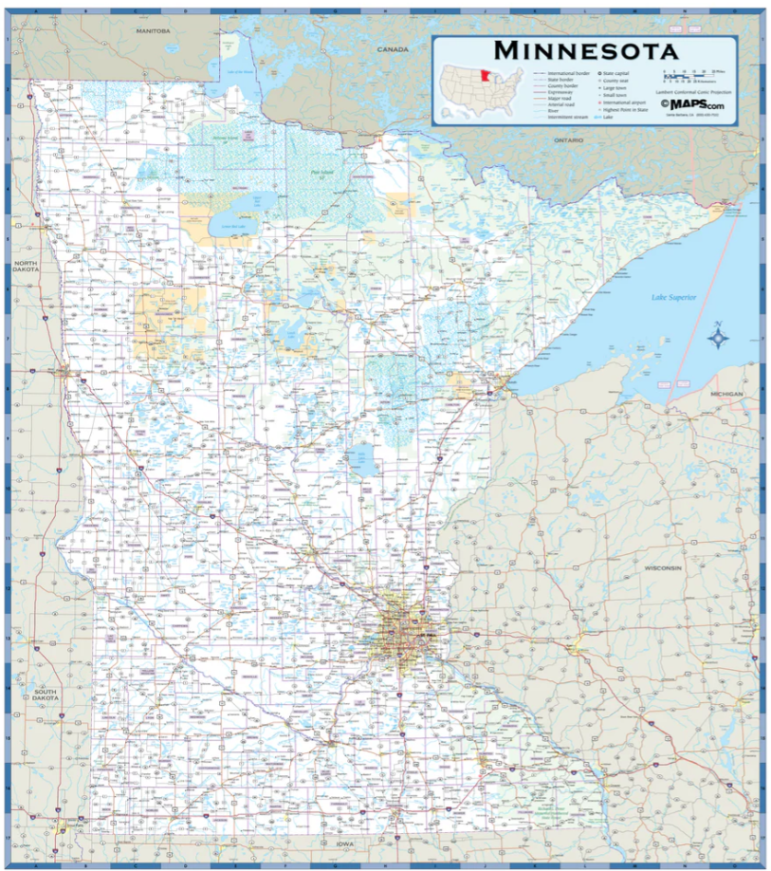
Understanding Traffic Patterns to Improve Transportation Planning
MnDOT need an interactive dashboard to:
Spot traffic peaks
Analyze weather impact
Highlight holiday trends
Help stakeholders explore data easily

Slide 3

Data Processing & Visualization
Data source: CSV file
BI Platform used: Tableau
Key steps:
Imported and cleaned the data
Built a pipeline directly in Tableau
Focused on time, weather, and holiday metrics
Visualizations included:
Year filter for dynamic exploration
Line chart: traffic volume per hour of the day
Line chart: traffic volume per month and year
Bar chart: traffic volume by weather condition
Bubble chart: traffic volume per holiday

Slide 4
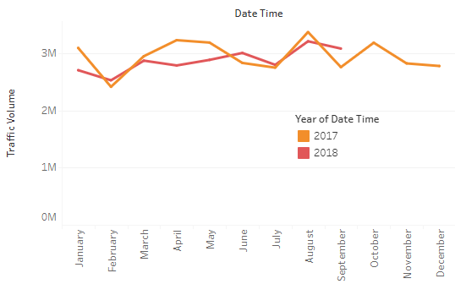
Monthly Traffic Volume per Year
August has the peak monthly traffic, indicating seasonal travel trends.
February has the lowest volume, ideal for maintenance work

Slide 5
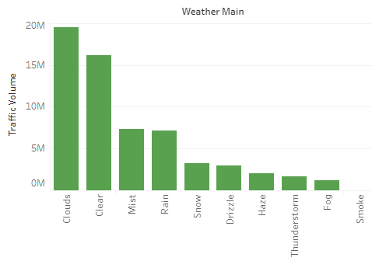
How the Weatherman affects Traffic Volume
Clear and cloudy days saw the most traffic
Low-visibility conditions result in the lowest traffic volume.

Slide 6
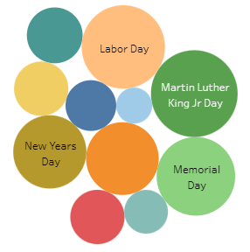
Holiday Travel
Labor Day and Martin Luther King Jr. Day recorded the highest holiday traffic volume
Most holidays have little impact on traffic volume.

Slide 7
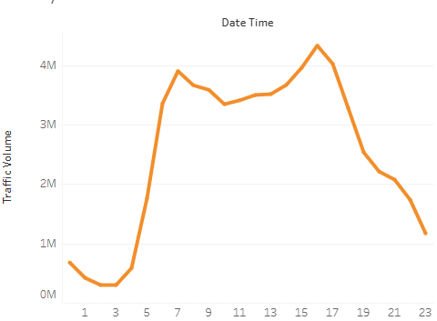
Hourly Traffic
Rush hours (7–9 AM and 4–6 PM) have the highest traffic volume.

Slide 8
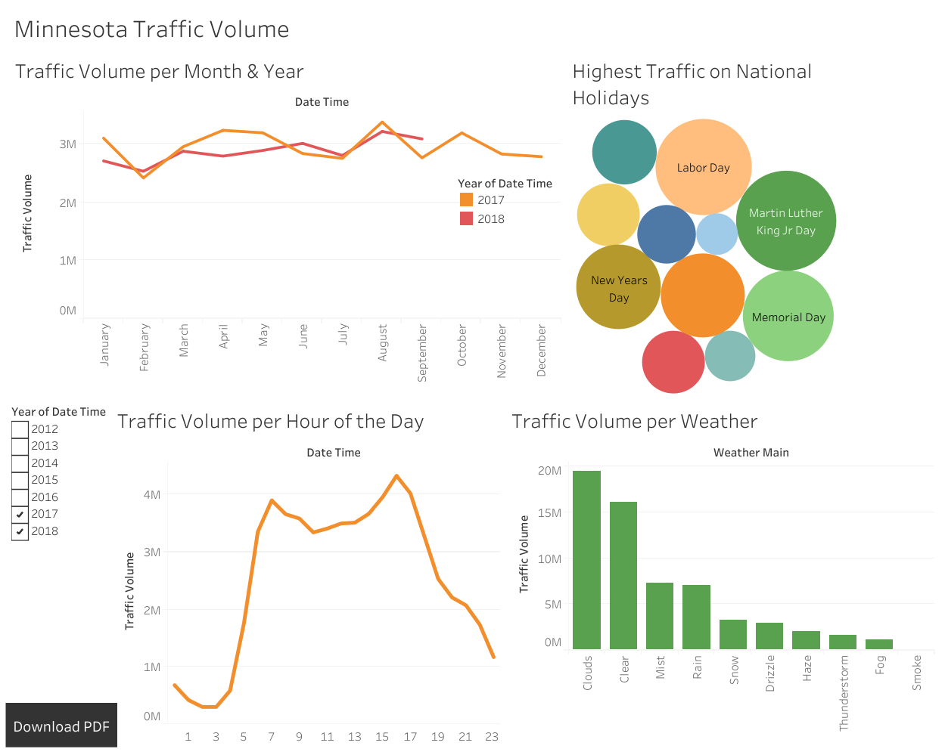
Dashboard Look
Fully accessible to Stakeholders
Live Monitoring
Filters by Year
Downloadable

Slide 9
Thank You!

